Slide 1
CORPORATE CULTURE AND HRM IN THE CONTEXT OF SOCIETY 5.0
Prof. Dr. Roselina Ahmad Saufi
Dean
Faculty of Entrepreneurship and Business
Universiti Malaysia Kelantan, MALAYSIA
1 July 2020

Slide 2
AGENDA
Definitions
Evolution of Society
Corporate Culture and Society
Point to Inculcate in Corporate Culture
HRM and Corporate Culture
Notes:
Construct(s): Check List
Layout: Basic
Style: Enhanced

Slide 3
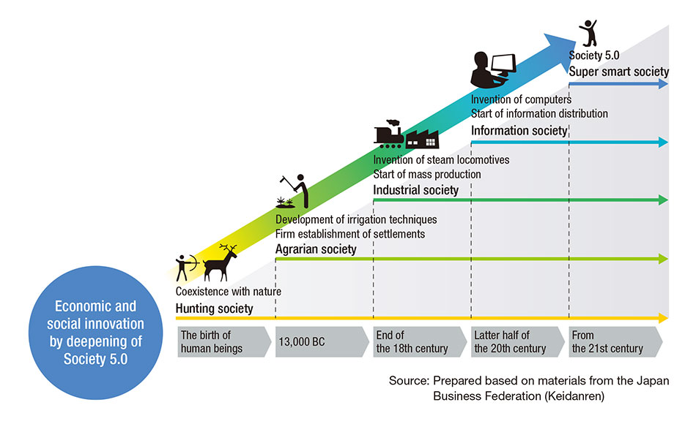
EVOLUTION OF SOCIETY 5.0
Society 5.0 refers to a modern society which effectively uses technology, robotics, computers, and communications systems, with the aim of improving the world in which we live.

Slide 4
DEFINITION
Corporate culture refers to the shared values, attitudes, standards, and beliefs
that characterize members of an organization and define its nature.
Its shapes people’s
Perception, attitude, communication, personality (individualism vs collectivism), shared values
Why Corporate culture is important?
Organisation's
Standards, leadership, performance, productivity, and reputation
Society’s
Sustainable development, economic development, resource preservation, social responsibilities.
Notes:
Construct(s): Filter
Layout: Basic
Style: Basic

Slide 5
DEFINITION
Society 5.0 refers to a modern society which effectively uses technology, robotics, computers,
and communications systems, with the aim of improving the world in which we live.
A human-centered society that balances economic advancement with the resolution of
social problems by a system that highly integrates cyberspace and physical space."
Employees
New knowledge, new set of skills, m methods of doing work, leverage on technology, human and machine must collaborate, game changer
What is the new corporate culture and how it affects Society 5.0?
Organisation
Agile/responsive to the environment, investment on new tech, empowering HR; Robotics, AI, & ecommerce adoption, system monitoring, ease complex decision making, flexible structure
Society
Super smart society, human empowerment, allow for game changers, gig economy.
Notes:
Construct(s): Filter
Layout: Basic
Style: Basic

Slide 6
CORPORATE CULTURE AND SOCIETY 5.0
With the evolution of society, corporate culture has transformed from profit
seeking to social welfare maximizing entity.
Social Welfare Impact – Human Empowerment and Game Changers
Narrowing Gender Gaps
Interactions between Organization and Consumers, Organization Concern for Aging Work Force
IMPLICATION ON HRM
Adoption of New Technologies
Innovative Retirement Plan
Work-life Balance & Employee well-ness
Stimulates Economic Growth & Sustainability of HR & Organisation

Slide 7
THE INTEGRATED HUMAN RESOURCE STRATEGY INFOSTERING INNOVATIVE CORPORATE CULTURE
Measurement
of Outcomes
Fair and just
Clear direction
Agile and responsive
Engaged and listen
Smart, agile, responsive, and resilience workforce
Technology infused, creative and innovative workforce.
High wellbeing and satisfaction.
Sustaining growh in human competencies
Sustaining economic growth of organization.
TRANSPARENT AND ETHICAL PRACTICES OF MANAGEMENT
Ethics and honest (ehsan)
Clear policy and guidelines
Consistent performance review
Work life balance
Work From Home
Empowering workforce
Performance based reward

